Slide 1
Urban Mobility Trends Unveiled: A Comprehensive Analysis of Lyft Bikes in San Francisco
Meta Team Members:
Divya Dodla (UA03330)
Naren Kandregula (PW71937)
Sachin Dudam (GG42052)

Slide 2

Project Description
GOAL : To analyze lyft Bay Wheels System Data of San Francisco Bay Area from the years 2021-2023 by performing Big Data operations, feature engineering, generating visualizations (EDA), and building prediction model based on the principles of Big Data to predict the potential bike availability at specific stations.
DATA :
Size of dataset: Approximately 1.24 GB.
Number of Records: 6,625,912 individual records.
The large dataset size necessitates leveraging distributed computing capabilities, and the complexity of the analysis demands scalable solutions to extract actionable insights from the wealth of information within the Lyft Bay Wheels System Data

Slide 3

Motivation
The increasing popularity of bike-sharing systems contributes significantly to sustainable urban transportation.
Analyzing the Bay Wheels System Data allows us to gain insights into user behaviors, station utilization, and broader trends, aiding urban planners and policymakers in making informed decisions to enhance the efficiency and accessibility of bike-sharing services.

Slide 4
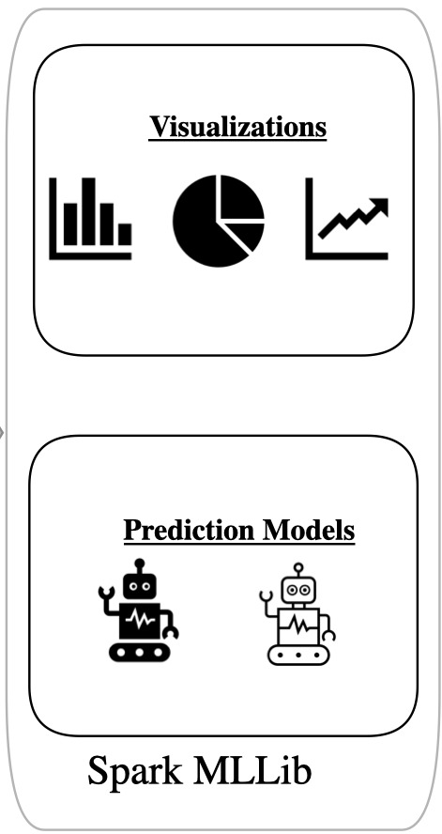




Implementation of Architecture
Input Data Source
Platform
Storage
Processing

Slide 5
Feature Engineering & Exploratory Data Analysis (EDA)
Missing values in categorical columns (Station Names and IDs) are filled with "Unknown" and rows with missing values in geographic coordinates (Latitude and Longitude) are removed.
Potential Canceled Rides Analysis
To filter the DataFrame to retain only valid rides by excluding two cases:
Keeping rides with a duration of 5 minutes or more.
Excluding rides with less than 5 minutes duration where the start and end stations are the same.
This ensures the Data Frame contains reliable ride data, filtering out potentially canceled or very short rides.
Number of potentially canceled rides: 311875
Total number of distinct stations: 603

Slide 6
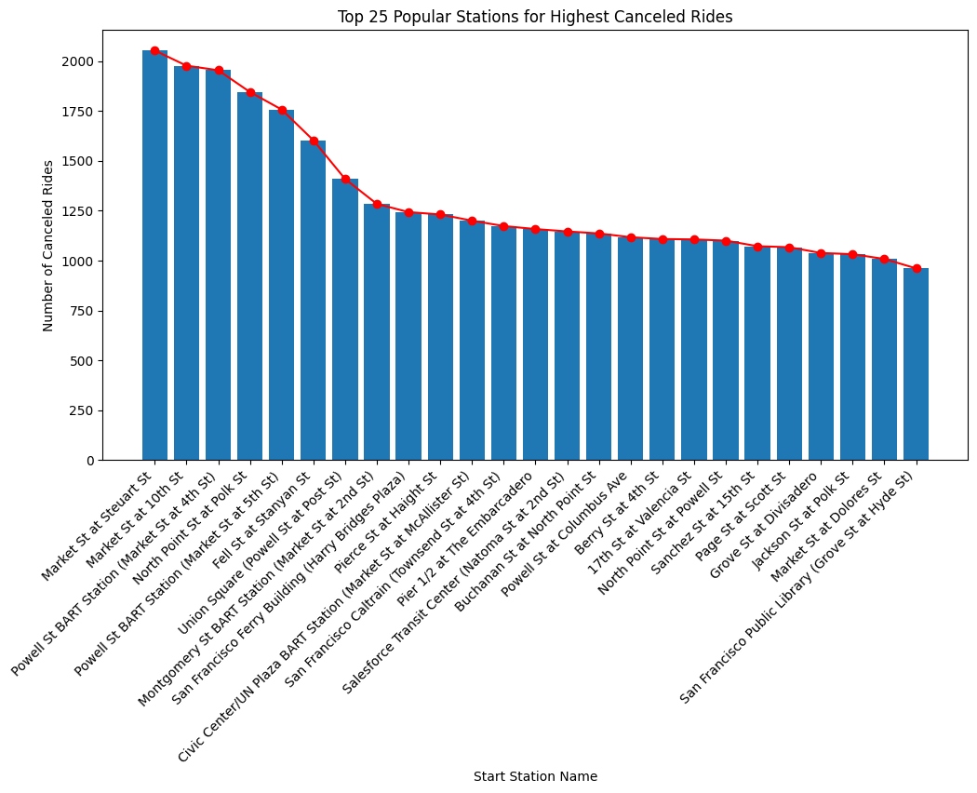

Slide 7
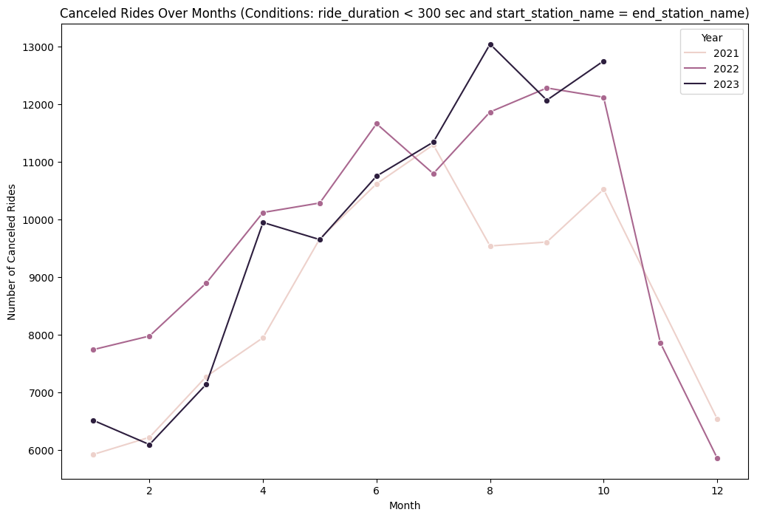
The graph shows that there are more canceled rides in the summer months, and that the number of canceled rides has increased over time.

Slide 8
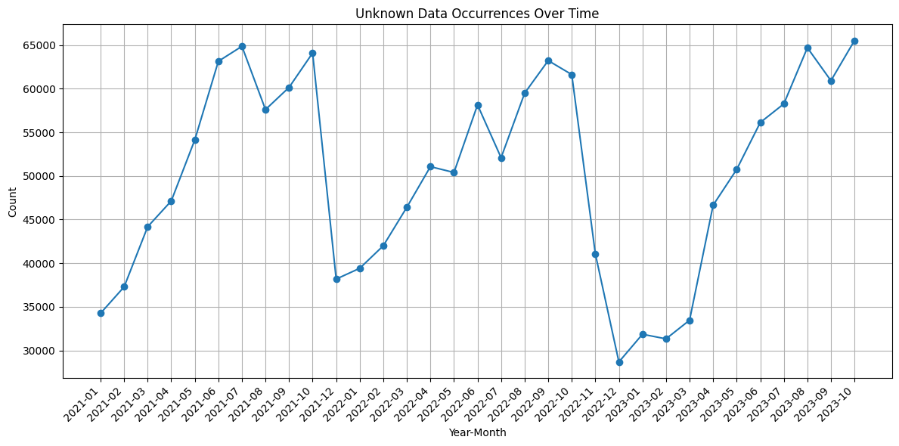
The unknown data is likely due to a number of factors, such as:
GPS errors
User input errors
Stations that are no longer in service
Stations that are not properly identified in the dataset
Unknown data occurrences in Lyft Bay wheels rides dataset decreasing over time, but still significant.
This insight suggests that Lyft is making progress in improving the accuracy and completeness of its dataset, but there is still room for improvement.

Slide 9
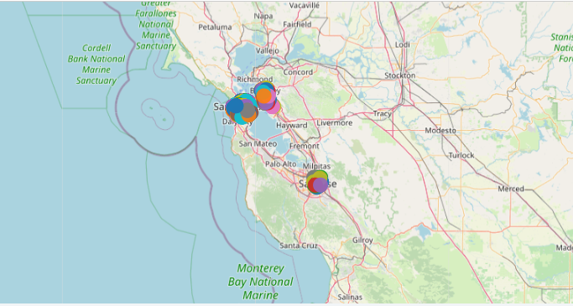
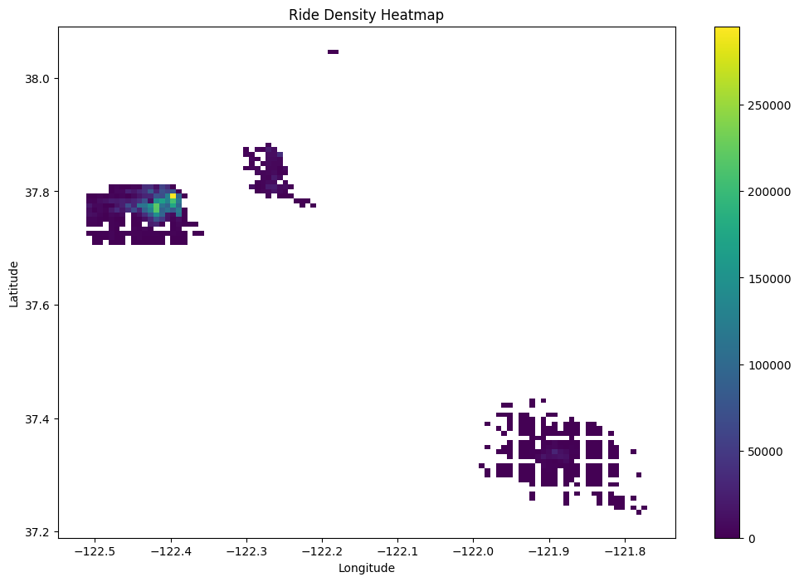
Stations
Lyft bike ride start stations are located throughout the San Francisco Bay Area, with a concentration in the downtown area.

Slide 10
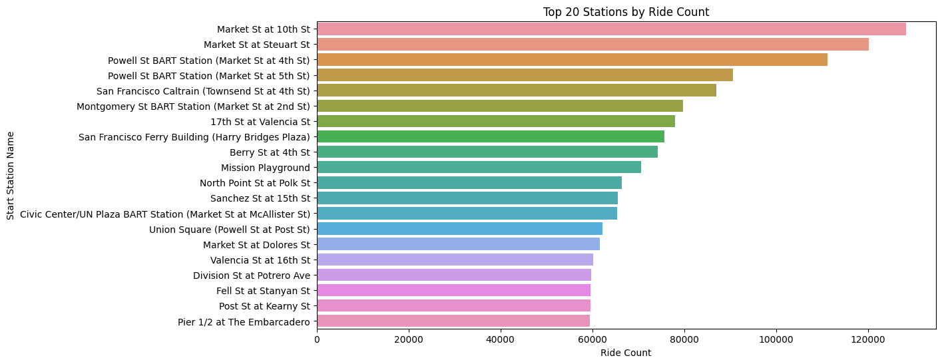

Slide 11
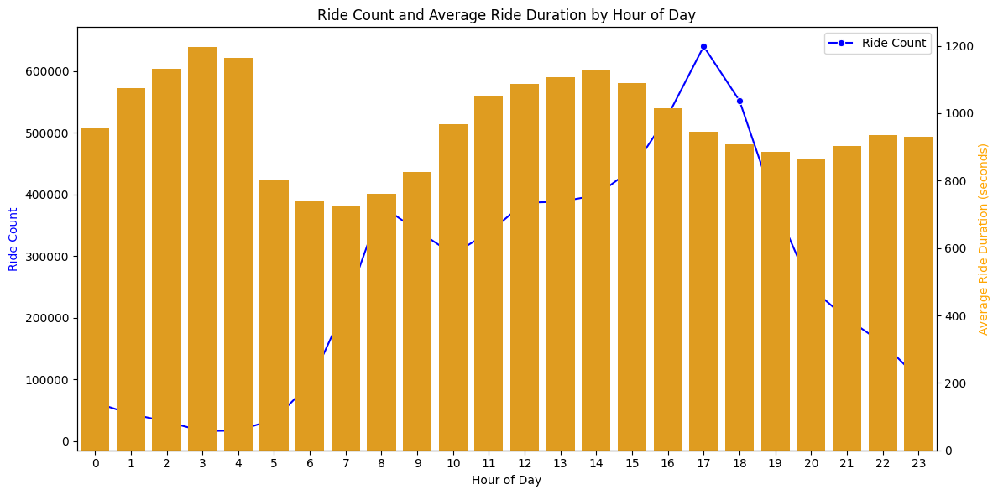
This insight suggests that people are more likely to take shorter rides during the day, and longer rides at night.

Slide 12
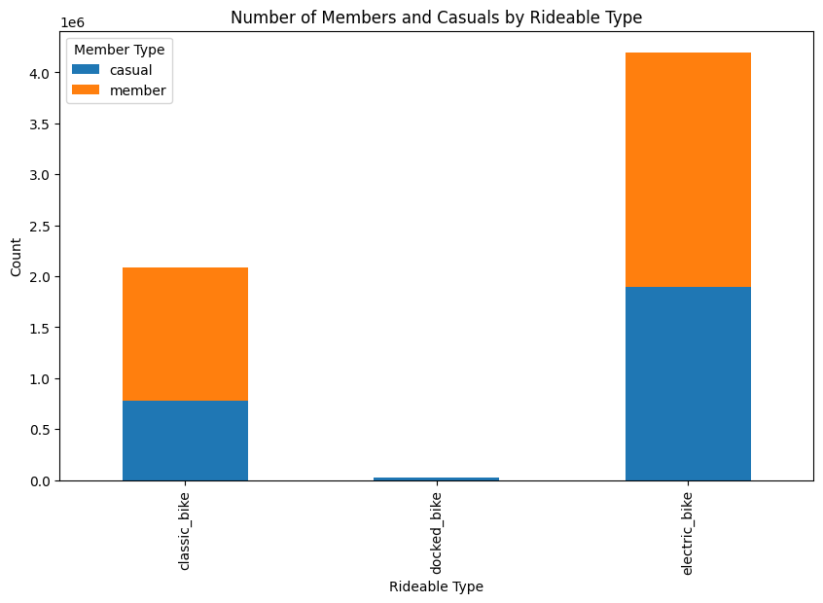
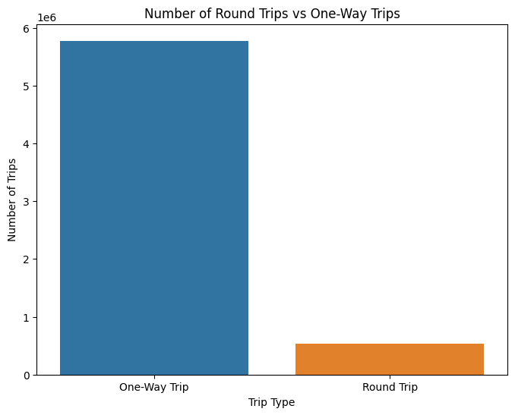
+-------------+-------+
|rideable_type| count|
+-------------+-------+
|electric_bike|4197496|
| classic_bike|2085406|
| docked_bike| 25252|
+-------------+-------+
+-------------+-------+
|member_casual| count|
+-------------+-------+
| casual|2702435|
| member|3605719|
+-------------+-------+

Slide 13
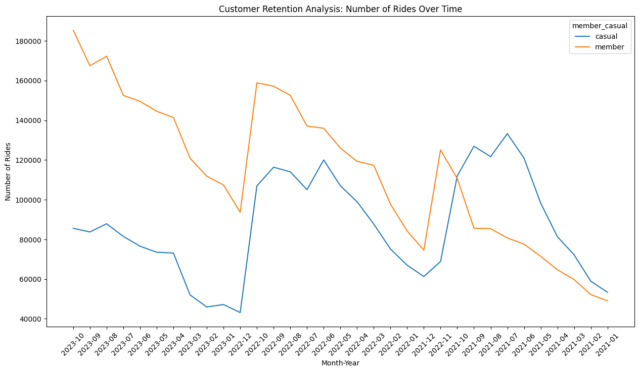
Lyft member rides increasing over time, while casual rider rides remain stable.
This insight suggests that Lyft is becoming more popular among regular riders, which could be due to a number of factors, such as the convenience and affordability of the service.

Slide 14
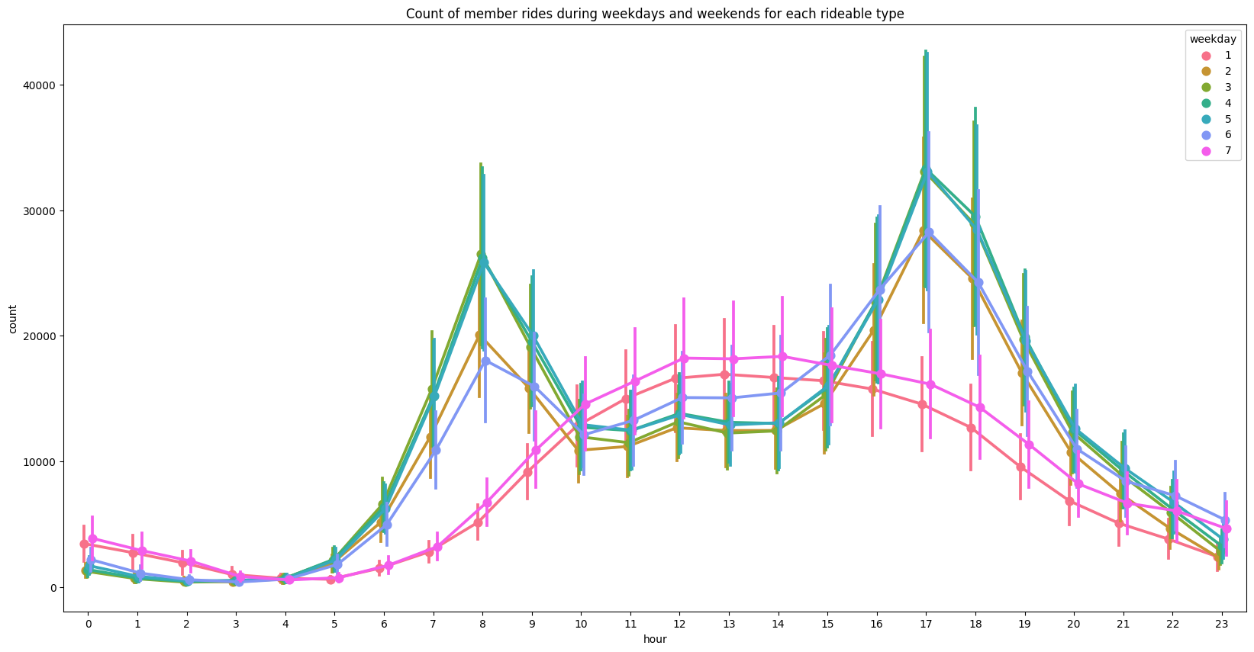
Average number of member rides higher on weekdays than on weekends.

Slide 15
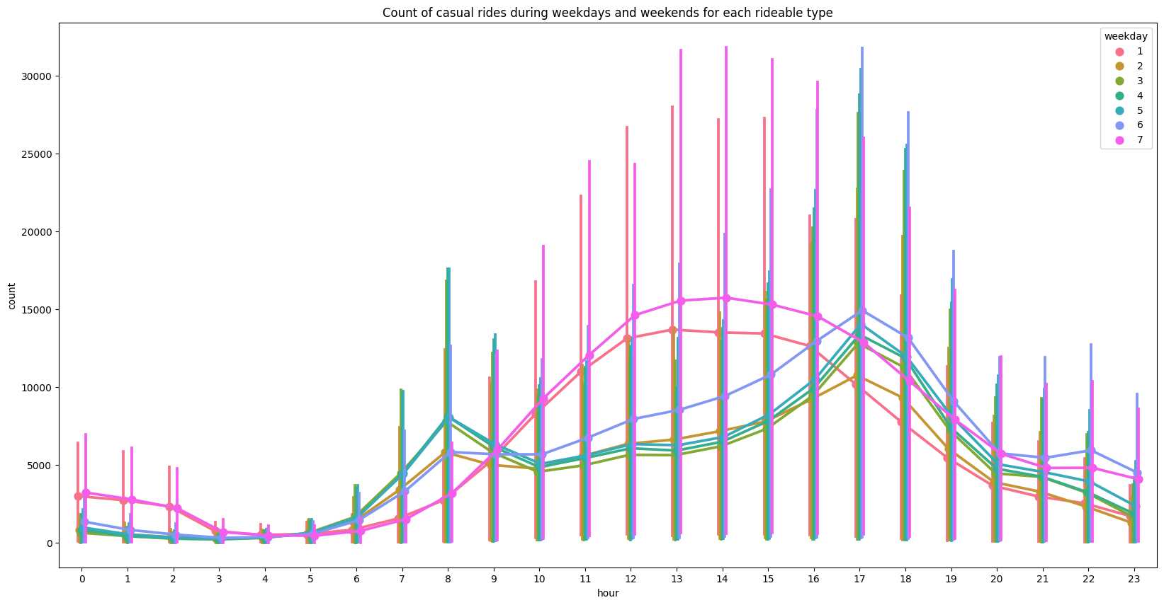
Average number of Casual rides higher on weekends than weekdays.

Slide 16
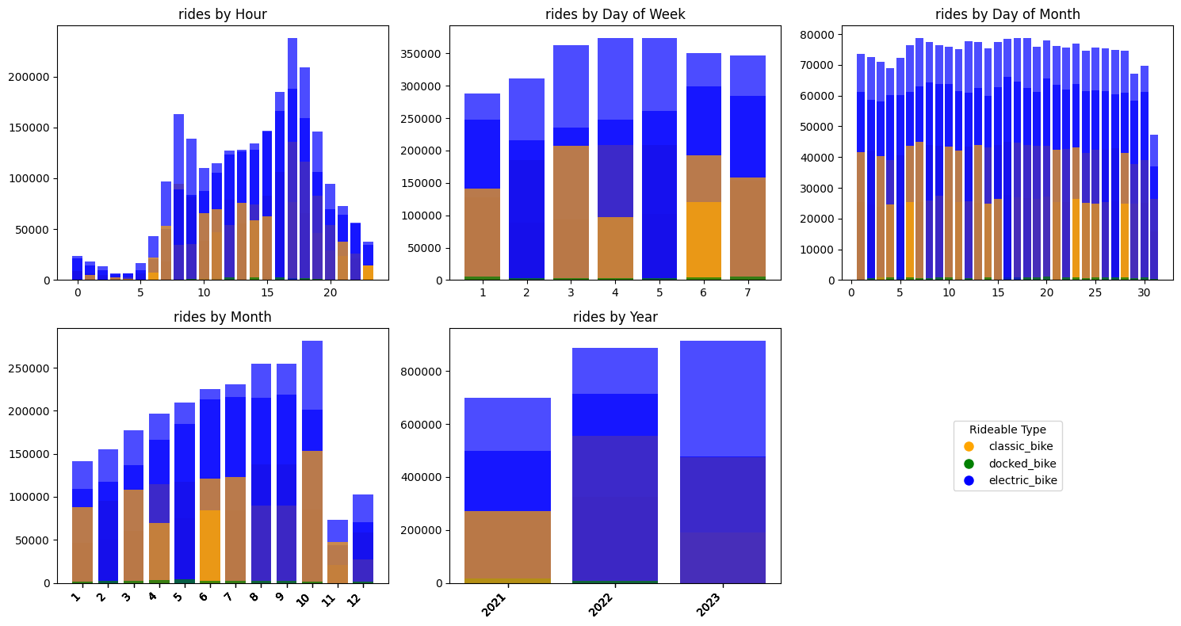
Bay Wheels rides peak in the morning and evening, lowest in the middle of the day and at night.

Slide 17
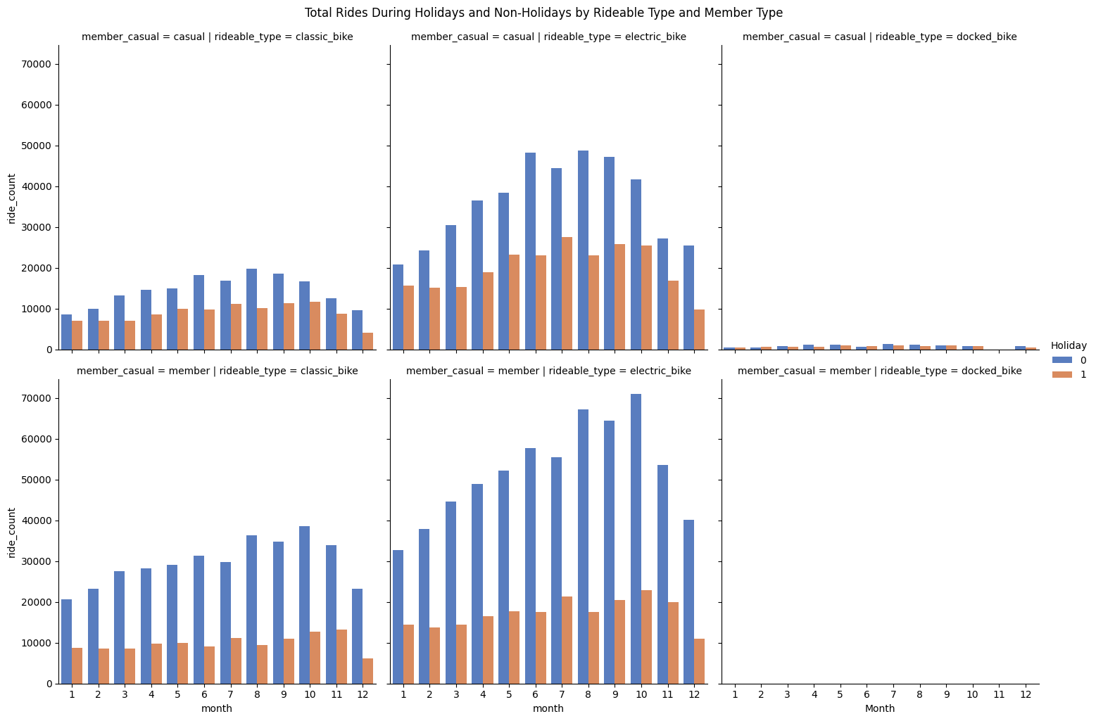
The holiday column includes weekends (Saturday and Sunday) and other specified holidays, adopted from Office Holidays - California, USA.

Slide 18
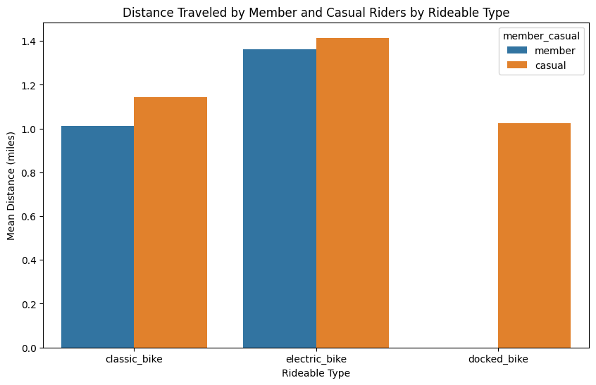
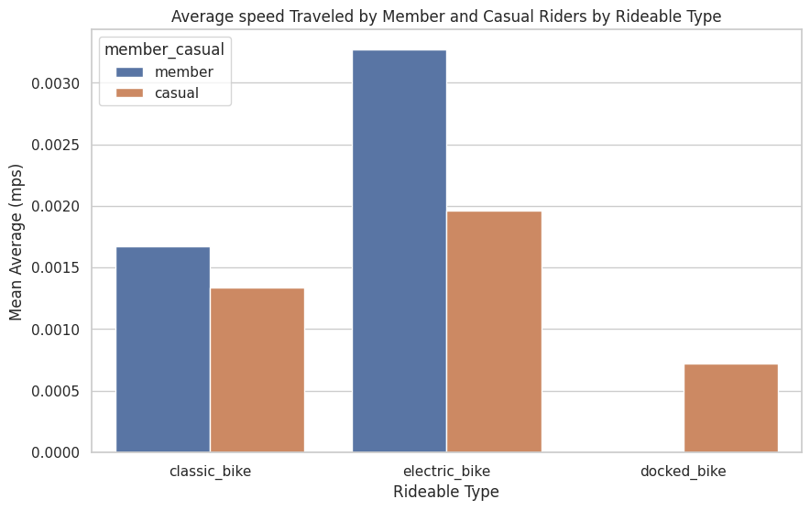
Casual riders travel further distances than member riders, regardless of rideable type.
Member riders travel faster than casual riders.
The geolocation distance calculation using the Haversine formula, as implemented through a User-Defined Function (UDF) and inspired by the article 'Calculating Distance Between Two Geolocations in Python', adds a new 'distance(miles)' column to the DataFrame using the latitude and longitudinal information and duration of rides.

Slide 19
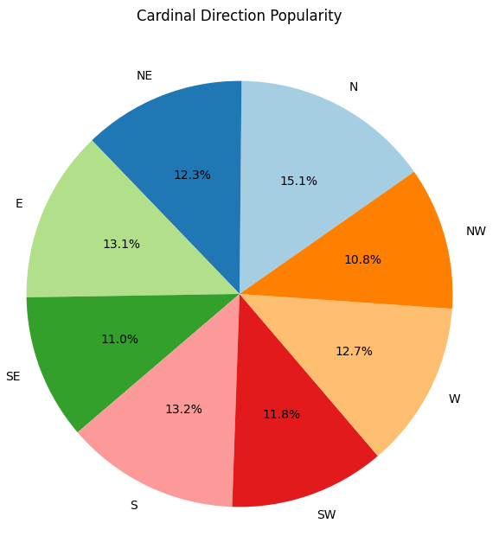
The largest segment, representing rides heading North, indicates a higher preference or need for travel in this direction. It might also reflect commuting patterns, which could be vital for urban planning and expansion of services. Understanding why certain directions are preferred could help Lyft optimize its network to better serve the community's transportation needs.
Inspired by the method detailed in the mapscaping reference, a User-Defined Function (UDF) is implemented to calculate the bearing between geographical coordinates, offering valuable insights into the direction of movement for analyzing ride patterns and trends in the dataset.

Slide 20
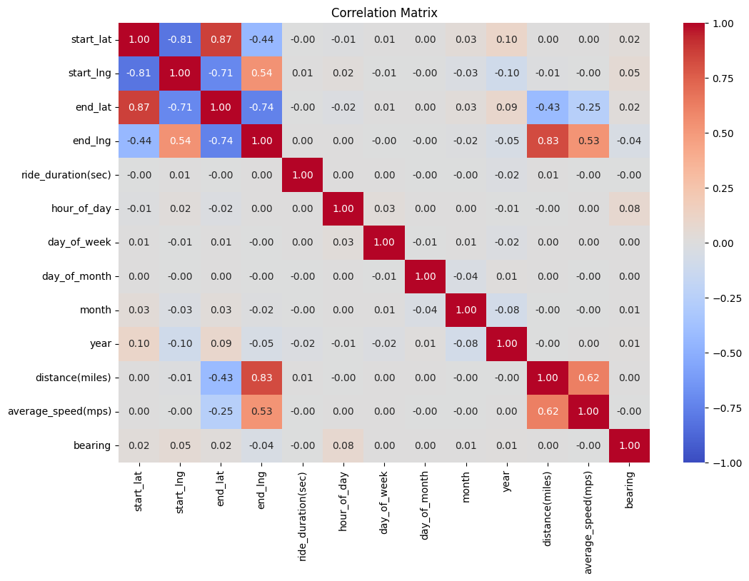
The correlation matrix shows how different features of Lyft Bay wheels rides are related to each other.

Slide 21
Predicting Potential Bike Availability at Specific Stations
Bike Availability Prediction Workflow:
Calculate hourly ride counts, create DataFrames, and join.
Handle missing values, aggregate counts, and compute availability.
Merge availability info with the original data.
Select features, transform for ML, and train Machine Learning Algorithms.
Overall, the ML encompasses preprocessing, feature engineering, and machine learning to predict potential bike availability.
Availability column Assumptions:
Positive differences imply increased availability, assuming immediate reflection.
Negative differences set to 0 uniformly, potentially overlooking fluctuations.
Binary classification (0 or 1) simplifies availability, missing nuanced variations.
Null values filled with 0 assume no rides mean no availability, potentially inaccurately handling missing data.

Slide 22
Machine Learning Model Performance Evaluation
The ROC (Receiver Operating Characteristic) curve is a metric for evaluating the performance of classification models. Accuracy is the proportion of correctly classified instances out of the total instances. Here are the ROC curve scores and Accuracy scores for different machine learning models:
Logistic Regression: 0.644 (ROC), 0.843(Accuracy)
Random Forest: 0.688(ROC), 0.782(Accuracy)
Multilayer Perceptron Classifier: 0.627(ROC), 0.843(Accuracy)
A higher ROC score and Higher Accuracy indicates better model performance in distinguishing between classes. The Logistic Regression Classifier demonstrates the highest ROC and Accuracy scores among the evaluated models, suggesting superior discriminatory power.

Slide 23
Insights & Urban Mobility Impact
Lyft is making it easy for people to find a bike to ride, no matter where they are in the city. This can help to encourage people to choose biking as a transportation option, which can have a number of benefits, such as reducing traffic congestion and improving air quality.
Electric bikes are popular among casual riders, covering longer distances at higher speeds compared to classic bikes.Peak ride hours and daily patterns reveal user behavior, aiding operational planning and resource allocation.
Ride counts fluctuate during holidays; understanding these patterns helps optimize services and promotions.
Cardinal direction analysis uncovers preferred routes, guiding station placements for enhanced accessibility.
Multilayer Perceptron model outperforms, providing reliable predictions of ride availability.
Data-driven insights reveal general user trends, guiding business strategies and user experience improvements.
The Urban mobility trends from this analysis will contribute valuable insights to urban planners, policymakers, and transportation enthusiasts interested in understanding and optimizing the dynamics of bike-sharing systems.

Slide 24
Future Scope
Apply the developed framework and insights to other cities with similar bike-sharing systems, adapting the model to local variations. This could contribute to a scalable solution applicable in diverse urban environments.
Can develop a model to suggest optimal routes for rides based on historical traffic patterns, road closures, and other relevant factors.
Can create a model to optimize the allocation of vehicles to different areas based on predicted demand and user behaviour.
By focusing on these areas, Lyft can potentially improve service reliability, customer satisfaction, and operational efficiency, ultimately enhancing the user experience and possibly reducing the rate of canceled rides.

Slide 25
References
System data: Bay Wheels. Lyft. (n.d.). https://www.lyft.com/bikes/bay-wheels/system-data.
Shaw, T. (2020, January 1). Federal holidays in California in 2023. Office Holidays. https://www.officeholidays.com/countries/usa/california.
Bhardwaj, A. (2020, June 14). Calculating distance between two geolocations in python. Medium. https://towardsdatascience.com/calculating-distance-between-two-geolocations-in-python-26ad3afe287b.
How to calculate bearing between two coordinates - December 4, 2023. mapscaping.com. (2023, November 7). https://mapscaping.com/how-to-calculate-bearing-between-two-coordinates/#:~:text=In%20Microsoft%20Excel%2C%20you%20can,x%2Daxis%20and%20the%20point.

Slide 26
Thank You…

